Slide 1











EU EMAIL COMMUNICATION NETWORK DATA ANALYSIS
PSTAT 194CS FINAL PROJECT PRESENTATION
By Bowie Chuang, Sunny Zhong, and Isabella Sri
Notes:
Sunny :)
Hi everyone, for our final project, we performed data analysis on the European Email Communication Network

Slide 2

ABOUT THE DATASET
The network dataset that we are analyzing was generated using email data from a large European research institution for 18 months from October 2003 to May 2005. There are 265214 nodes and 420045 edges. Each node represents a unique email address from the research institution and each edge represents an email interaction, indicating that at least one email was sent from one email address to the other or to itself.
Notes:
Sunny

Slide 3

OBJECTIVES OF THE ANALYSIS
The objective of this network analysis project is to explore, identify, and analyze the connections between email addresses based on email interactions within the research institution. By leveraging a comprehensive dataset, we aim to uncover insights into the structure, dynamics, and patterns of communication within the institution.
Notes:
Sunny

Slide 4
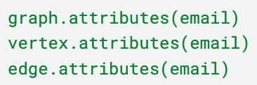
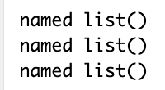
INITIAL OBSERVATION OF THE DATA
In the first stage of the project, we performed an initial examination of the entire network dataset to check for any attributes. The examination revealed that our network dataset has no attributes.
Notes:
Sunny

Slide 5

METRICS ANALYSIS OF THE ENTIRE NETWORK DATASET
Graph
Density
Reciprocity
Articulation
Point
Transitivity
5.97e-06
0.26005
4714
0.0041
Notes:
Sunny
The graph density value is very small, indicating that nodes within this network are sparsely connected. The reciprocity rate of around 0.26 shows that about 26% of direct edges between two nodes have an opposite counterpart. The articulation points of 4714 shows that thousands of nodes are contributed to the overall network connectivity. The transitivity value of 0.0041 indicates that only a few three-vertex connections form triangles or small cluster communities.

Slide 6
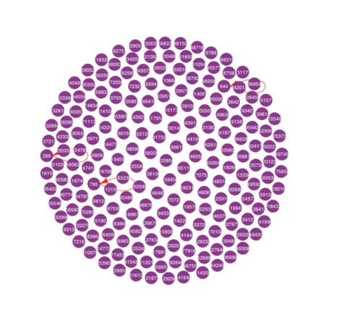
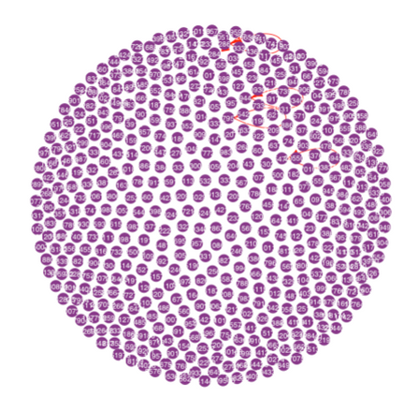
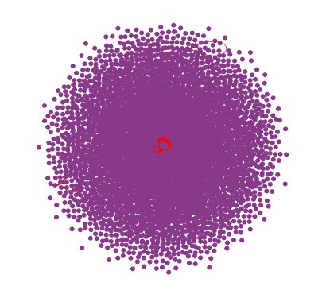
GENERATING INDUCED SUBGRAPHS USING RANDOM SAMPLING
200 NODES
500 NODES
5000 NODES
Based on the three plots of the induced subgraphs using random sampling (200, 500, and 5000), we can see that analyzing the subgraphs of this network dataset using random sampling is not effective.
Notes:
Sunny
We initially took a random sample of 200 nodes to generate a subgraph to observe individual nodes, but this resulted in only three edges, which are self-sent emails. We increased the sample size to 500 nodes that yielded similar results. Even with a sample size of 5000 nodes, the plot showed mostly unconnected nodes with some connections at the center. This shows that random sampling is ineffective for analyzing this network dataset. Now we will be talking about what we did instead.

Slide 7
EXPLORING THE EMAIL ADDRESSES THAT SENT EMAILS TO THE MOST RECIPIENTS AND RECEIVED EMAILS FROM THE MOST SENDERS
Because our dataset does not have many connections, we decided to analyze relationships within the institution by identifying nodes with numerous connections. We discovered that Node 84 sent out emails to the most recipients, totaling 930 recipients. Additionally, node 179171 received emails from the most senders, amounting to 7631 senders. These users likely hold significant roles within the network. We hypothesize that a user sending and receiving a high volume of emails may be more deeply connected to their community and potentially hold a leadership position with many individuals reporting back to them.
Notes:
Bella

Slide 8
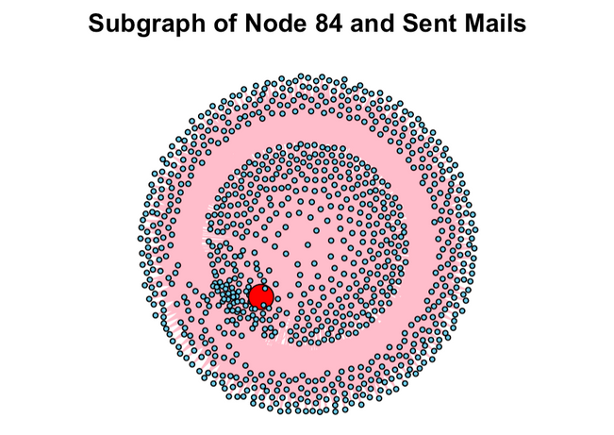
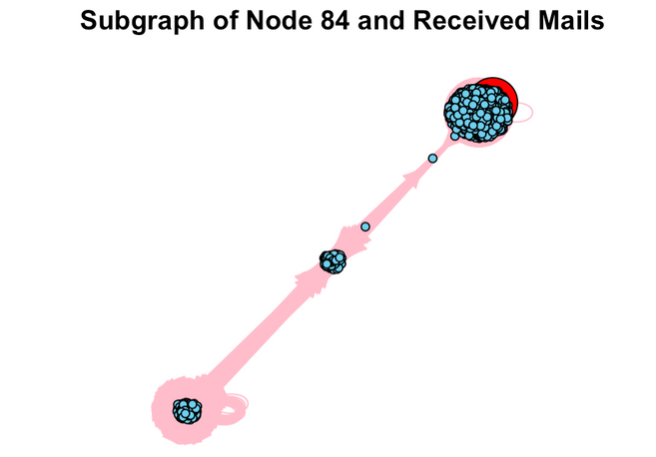
LOOKING CLOSER AT NODE 84, THE USER WHO SENDS TO THE MOST RECIPIENTS
THE PLOT OF NODE 84 AND THE RECIPIENTS IT SENT EMAILS TO
THE PLOT OF NODE 84 AND THE SENDERS IT RECEIVED EMAILS FROM
Notes:
Bella
-looking at these plots for node 84's sent and received mail, we can see that theres a large difference between the apparent networks of sent and received mail.
-this indicates that the node's high volume of sent mail is probably due to their position, not direct, two-way communications they're having with other people at the institution

Slide 9
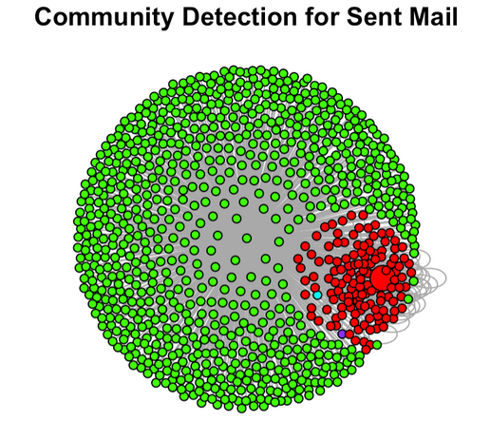
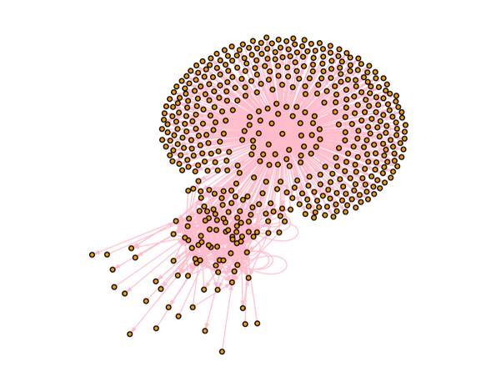
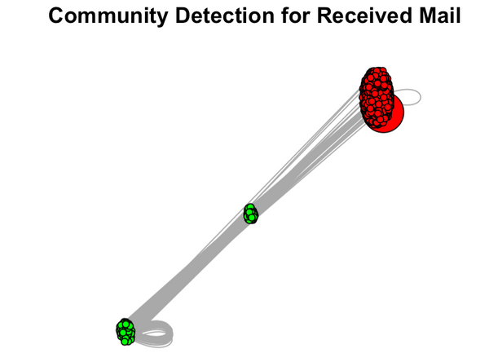
LOOKING CLOSER AT NODE 84, THE USER WHO SENDS TO THE MOST RECIPIENT
COMMUNITY DETECTION PLOT OF NODE 84 AND THE RECIPIENTS IT SENT EMAILS TO
SUBGRAPH OF NODE 84 USING A RANDOM SAMPLE OF 930 EDGES
COMMUNITY DETECTION PLOT OF NODE 84 AND THE SENDERS IT RECEIVED EMAILS FROM
Notes:
Bella
- from these plots, we can see node 84 sends mail to a lot of users without any edges between them, as well as to a small inter-connected community.
- This might mean node 84 holds a staff/faculty type of position, where they send mail to faculty members who are connected amongst themselves, as well as to students who we think would not have as many edge connections between themselves

Slide 10
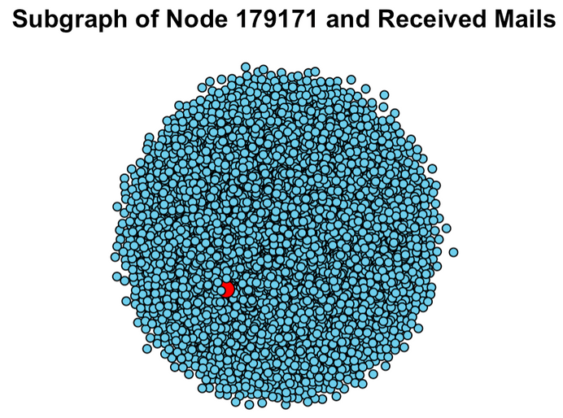
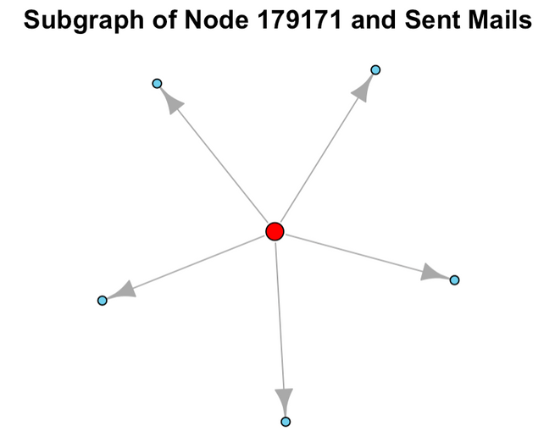
LOOKING CLOSER AT NODE 179171, THE USER WHO RECEIVED EMAILS FROM THE MOST SENDERS
THE PLOT OF NODE 179171 AND THE SENDERS IT RECEIVED EMAILS FROM
THE PLOT OF NODE 179171 AND THE RECIPIENTS IT SENT EMAILS TO
Notes:
Bella
- similar to node 84, there is a stark contrast between the plots for sent and received mail for the node that received the most mail, as this node has only sent mail to 5 other nodes.
- this indicates that nodes with high volumes of sent and received mail might be in positions within the institution where they are responsible for either distributing or receiving information from a lot of people, and not necessarily that they are people who are just in direct communication with a lot of other people

Slide 11
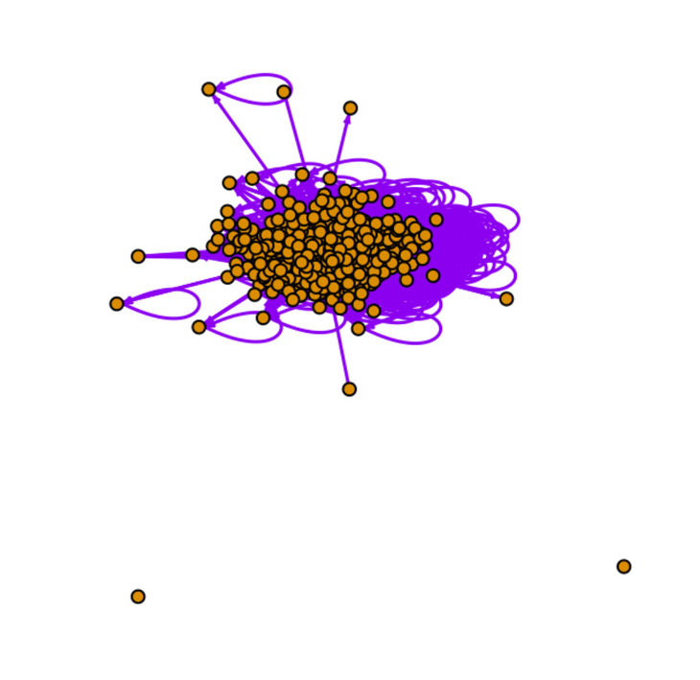
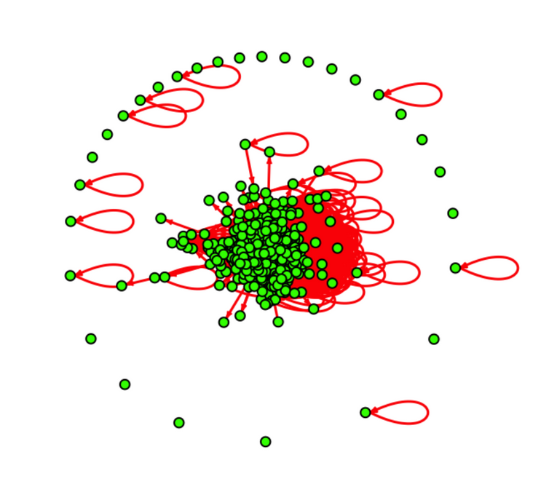
EXPLORING THE CONNECTIONS BETWEEN EMAIL ADDRESSES THAT SENT AND RECEIVED OVER 100 EMAILS
EMAIL ADDRESSES THAT SENT OVER 100 EMAILS
EMAIL ADDRESSES THAT RECEIVED OVER 100 EMAILS
Notes:
Bowie
- After looking at the top email senders and receivers, we decided to explore the connections between email addresses that sent and received over 100 emails.
- First, let's look at the plot on the left. It represents the email addresses that sent over 100 emails. Notice how these email addresses are involved in a large number of interactions with various other addresses in the subgraph network. This indicates that those who send a high volume of emails tend to engage in broader communication networks, actively reaching out to multiple recipients who also send out a lot of emails.
- Now, shifting our focus to the plot on the right. This plot represents the email addresses that received over 100 emails. Here, we see a somewhat different pattern. While there are still many interactions, there are more repetitive connections on the outer circle of the graph, suggesting that these email addresses often receive emails people not in the filter network. This might imply that those who receive a high volume of emails could be central figures or key points of contact within their respective networks.
- In summary, these plots demonstrate the different dynamics and roles within our email communication network.
Received 702
Sent 370 something

Slide 12
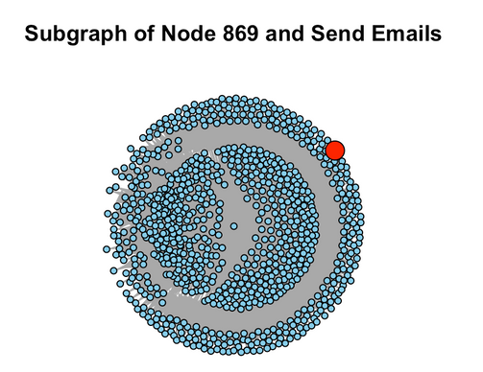
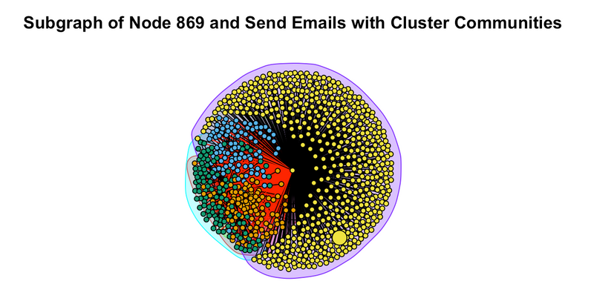
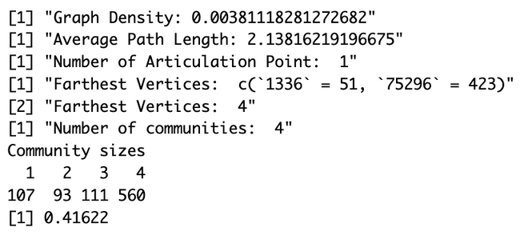
EXPLORING THE TOP 3 EMAIL ADDRESSES THAT SENT OUT EMAILS TO THE MOST RECIPIENTS AND PERFORMING METRICS ANALYSIS
THE SUBGRAPH FOR ALL NODES THAT NODE 869 SENT TO
THIS SHOWS THE COMMUNITY FOR THE SUBGRAPH FOR NODE 869
NODE 869 METRICS RESULTS
Notes:
Bowie
- We decided to explore the top three email addresses that sent emails to the most recipients. We focused on the number of emails sent rather than received because sending emails suggests active engagement and potential leadership roles, whereas receiving many emails does not necessarily indicate activity.
- Since we have already analyzed the top email address, Node 84, we will now focus on the other two email addresses that also sent a large number of emails: Node 869 and Node 193. Due to time constraint, we are not going to talked about Node 193 in this presentation
- We plotted two graphs for Node 869, along with our metric analyses. Although the graph appears strongly connected in the subgraph community, the graph density is actually just 0.0038, indicating that it is not densely connected. This makes sense, as most of the nodes in this connection are centered on receiving emails from Node 869, with Node 869 being the only articulation point.
- Additionally, we observed that the average path length for this subgraph is around 2.14. This suggests that emails sent from Node 869 are not forwarded many times from one person to another within the network. The diameter, or the farthest distance between vertices, shows that an email sent from Node 869 has been forwarded a maximum of four times.
- We also run the fastgreedy.community() algorithm, it created four separate communities within the subgraph. This indicates that the emails sent by Node 869 are classified into four distinct groups. However, we were unable to analyze why certain nodes within the network are grouped together due to the lack of attributes in this dataset and our limited knowledge of analyzing communities in social network analysis.
- This analysis highlights the proactive engagement of certain nodes and provides insights into the structure and connectivity of the network.

Slide 13
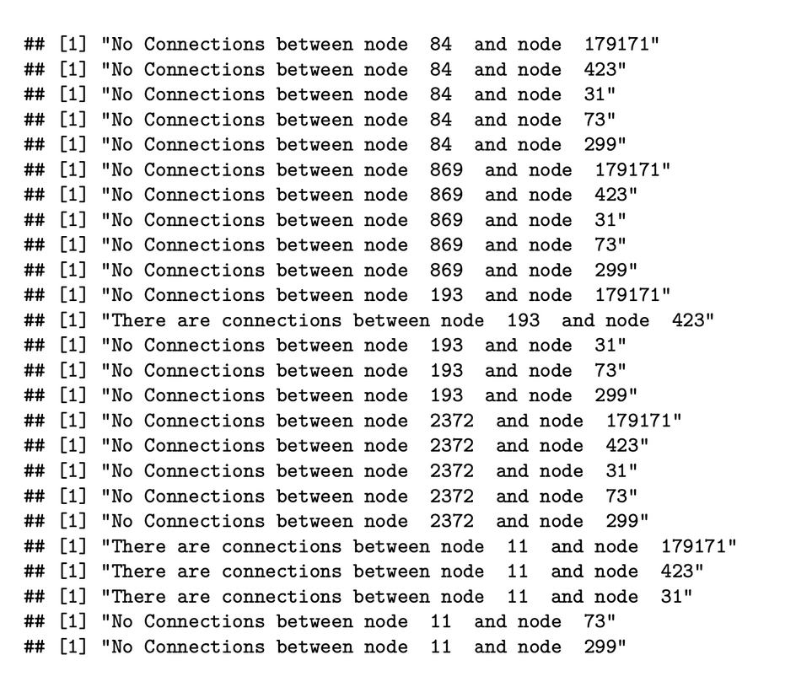
EXPLORING THE CONNECTIONS
THE TOP 5 EMAIL ADDRESSES THAT SENT EMAILS TO THE MOST RECIPIENTS AND THE TOP 5 EMAIL ADDRESSES THAT RECEIVED EMAILS FROM THE MOST SENDERS
The results show that there are no connections between the top 5 email addresses that sent emails to the most recipients and the top 5 email addresses that received emails from the most senders.
Notes:
Bowie

Slide 14
SUMMARY & REFLECTION
There is a very limited number of connections and communities when analyzing the graph density of the network
Sampling a certain number of nodes is ineffective because most nodes are not connected to each other
However, examining users who have sent emails to over 100 recipients gives us a better idea of the connections that do exist within the institution
The top 5 senders and receivers are not connected with each other, suggesting they either have significant overlap in their connections or each maintains their own distinct network.
Due to limitations, we were unable to run community detection, generate an adjacency matrix, or calculate degrees
Notes:
Sunny: first 3 points
Bowie: last 2 points

Slide 15
THANK YOU!

